Slide 1
SECURE DATA HIDING IN IMAGES USING STEGANOGRAPHY
CAPSTONE PROJECT
Presented By:
Student Name : Tanish Agrahari
College Name & Department : Microtek College of Technology and Management, BCA Department

Slide 2
OUTLINE
Problem Statement
Technology used
Wow factor
End users
Result
Conclusion
Git-hub Link
Future scope

Slide 3
Problem Statement
While implementing image-based encryption and decryption, I encountered an issue where the password saved during encryption was not being recognized during decryption. Initially, I tried linking the code using functions and module imports, but it didn’t work as expected. To resolve this, I created a password.txt file to securely store and retrieve the password, ensuring smooth encryption and decryption without errors.

Slide 4
Technology used
Python
Open CV
File Handling (For password storage)
NumPy

Slide 5
Wow factors
Implemented a dedicated folder for password storage to avoid misinterpretation.
Enhanced security by separating the encrypted message and authentication credentials.
Improved accessibility with an easy-to-use encryption-decryption interface.

Slide 6
End users
Individuals requiring secure communication.
Organizations handling confidential data.
Cybersecurity enthusiasts exploring steganography techniques

Slide 7
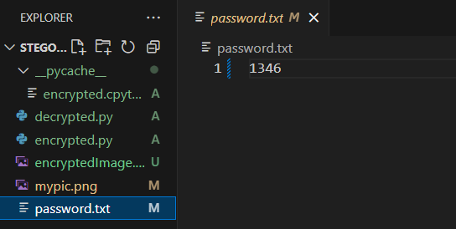
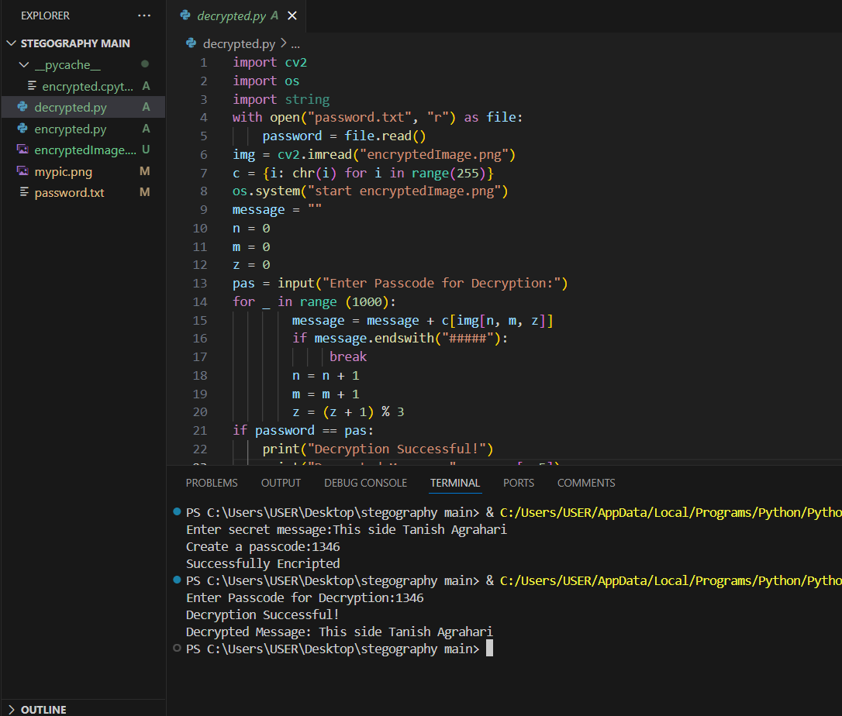
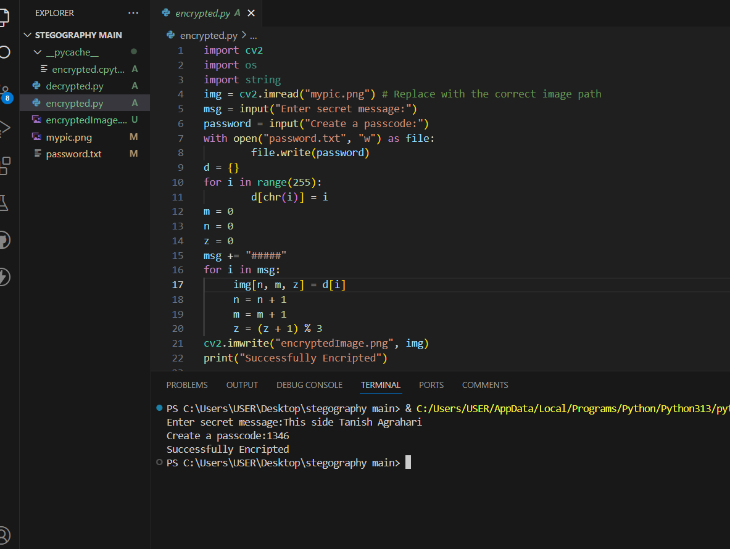
Results
Screenshots of the outcome (min 3)

Slide 8
Conclusion
This project successfully demonstrates secure message encryption using image steganography while overcoming password storage issues. The innovative password folder ensures better security and usability, making the decryption process seamless.

Slide 9
GitHub Link
https://github.com/TanishAgrahari/Steganography.git

Slide 10
Future scope(optional)

Slide 11
THANK YOU

